Slide 1

HTML ELEMENT
H A S A N
=[If you have a chance to fix your mistake, what will you fix first?]=

Slide 2

What is HTML Element?
Element is defined by start tag, content, and an end tag.

Slide 3
An element
<start tag> content </end tag>

Slide 4

Typography
Image
Table
Box
Form
How many types HTML Element?

Slide 5
HTML element features
Nested
Empty Element
Not case sensitive

Slide 6
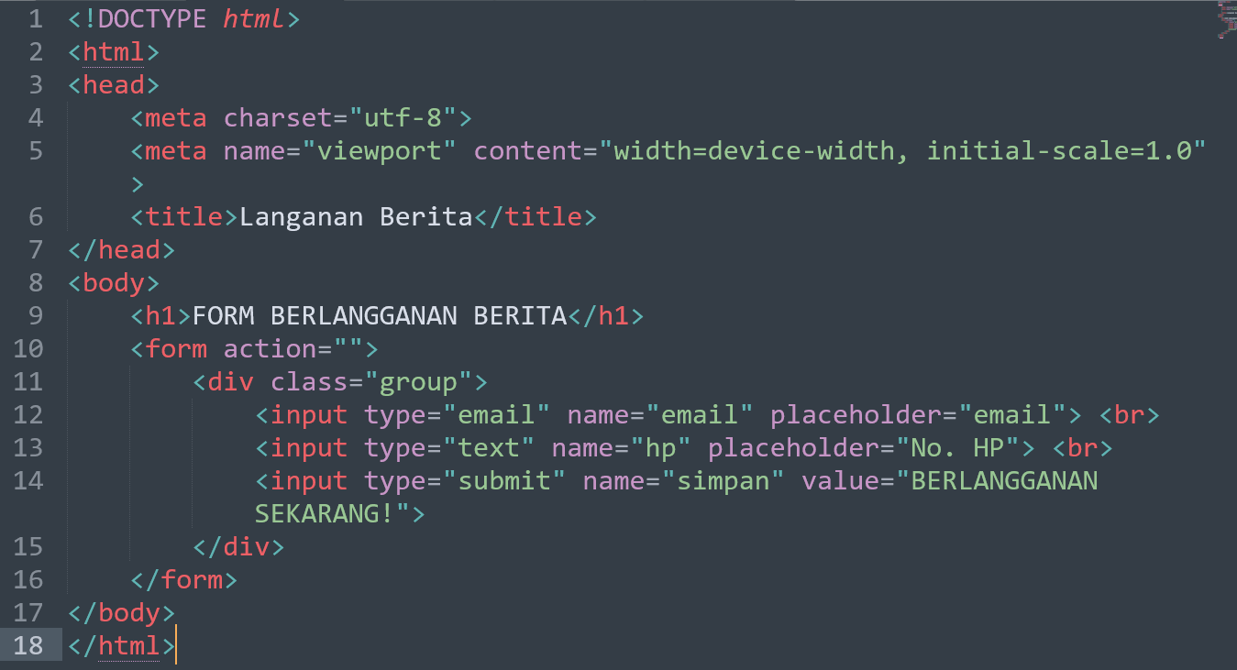
Nested HTML element

Slide 7
Empty HTML element

Slide 8
Not case sensitive HTML element

Slide 9
Case Study – Creating HTML Table
Data Pelanggan Berita
No | Data |  |  | Aksi
 | Nama | Email | No. HP
1 | Hasan | emailhasan@gmail.com | 081315269591
2 | Data lain | datalain@gmail.com | 081215269591
3 | Data baru | databaru@gmail.com | 081215269592
Edit
Hapus
Edit
Hapus
Edit
Hapus

Slide 10
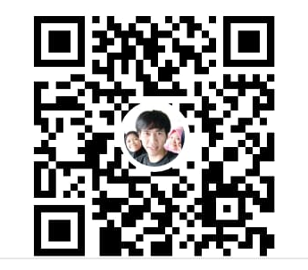
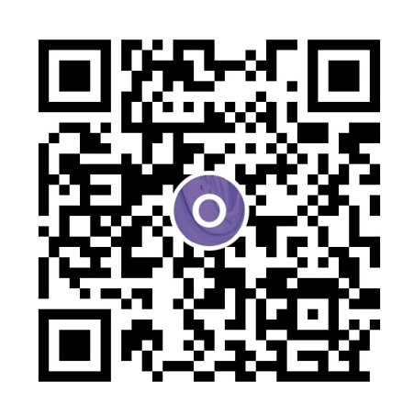






Buy me a coffee?
Any question?
wa.me/6281315269591
https://github.com/hasanalbantani
https://www.youtube.com/
channel/UCBrN_tGzXfciVJtIkT43I4w

Slide 11


